Slide 1
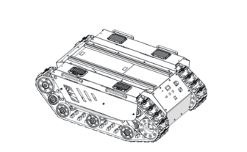
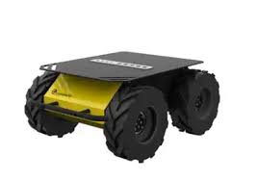
670mm
780mm
1023mm
990mm
390mm
394mm

